Slide 1
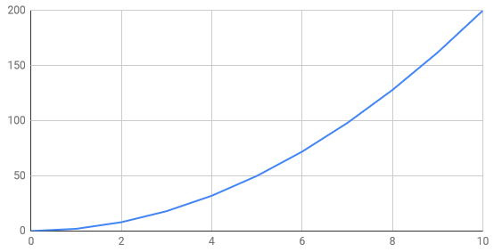
Creating Line Graphs using Google Suite

Slide 2
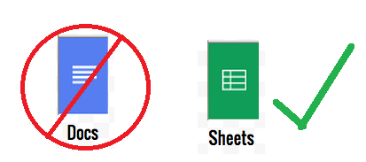
First off while Google Docs says it can create graphs IT IS A LIE.
It just creates a new Google Sheets puts the information there and then copies it over to the Google Doc.
Take Away: Just create it in Google Sheets you will have more control.

Slide 3
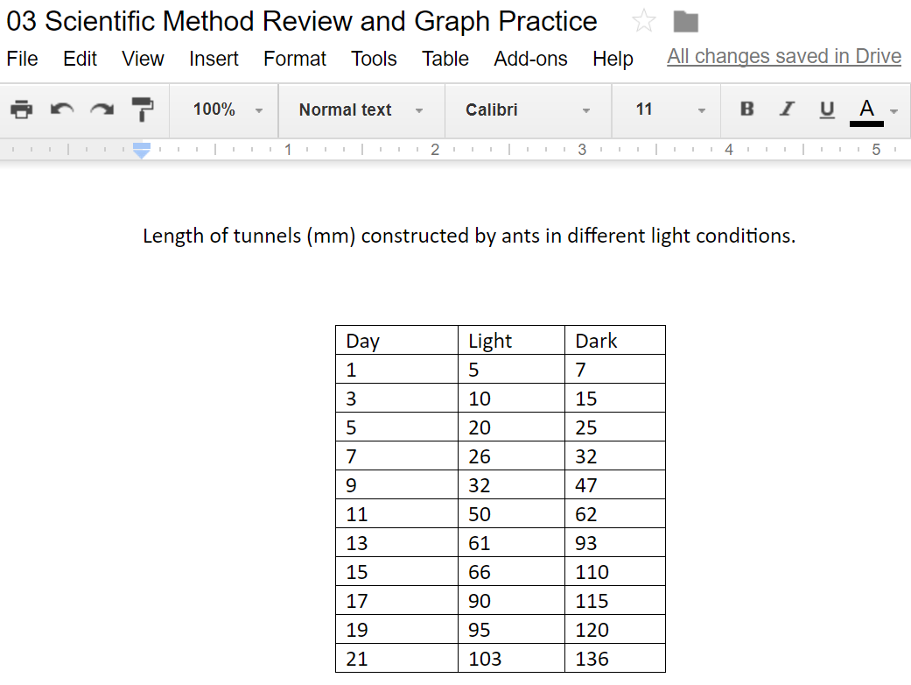
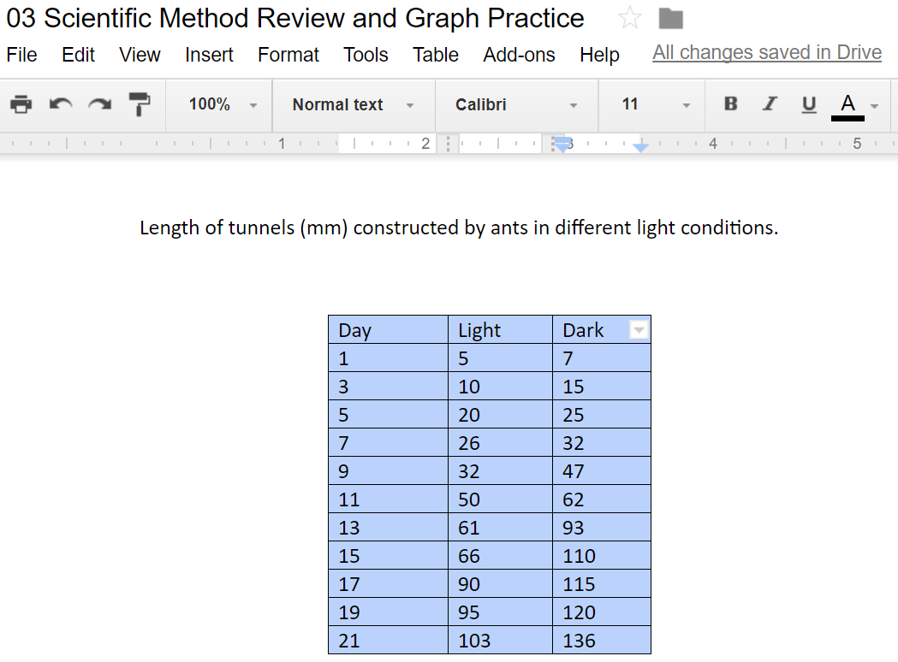
Collect your Data in Google Docs
2. Copy Your Data Table by selecting it

Slide 4
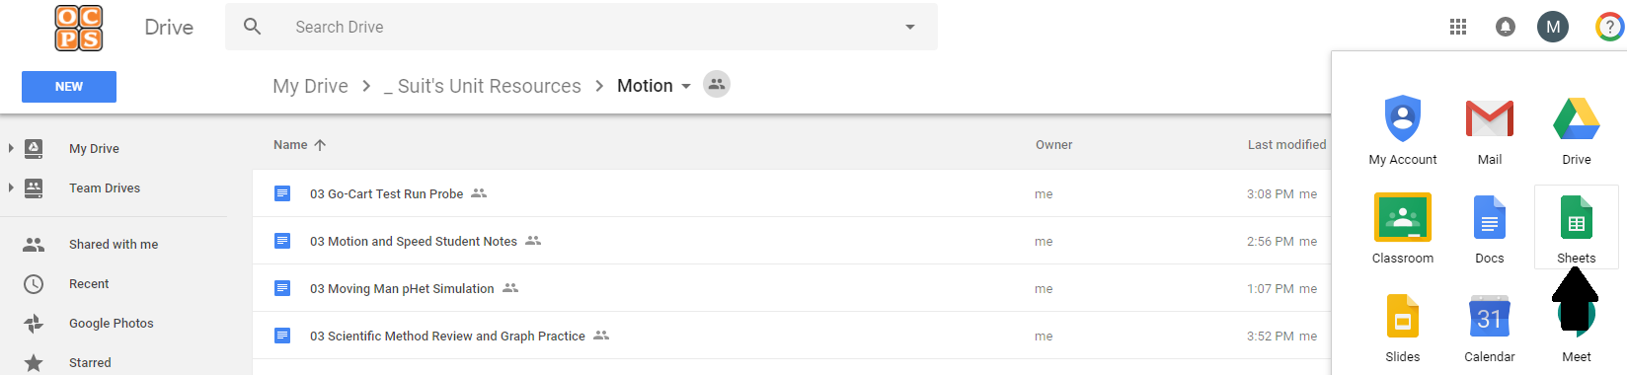
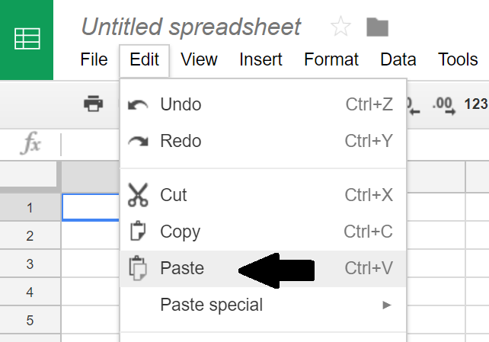
3. Open Google Sheets
4. Paste Your Data Table in

Slide 5
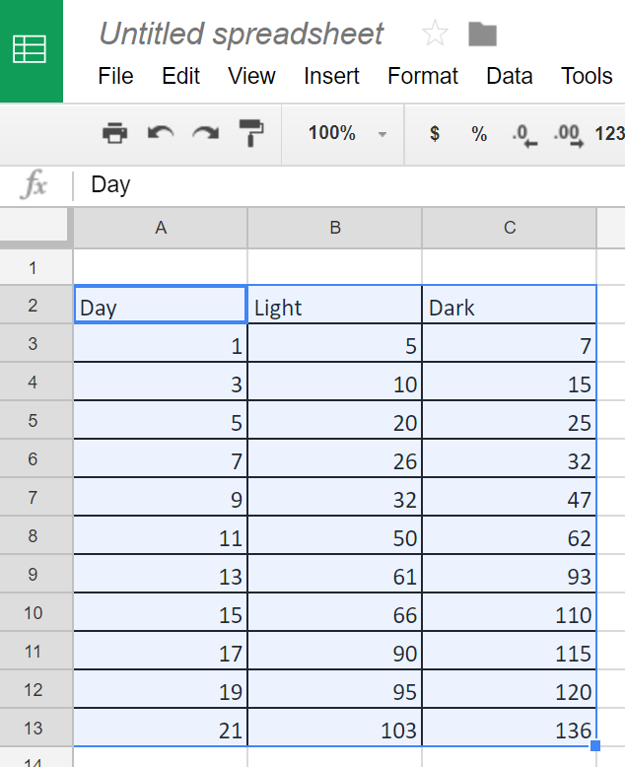
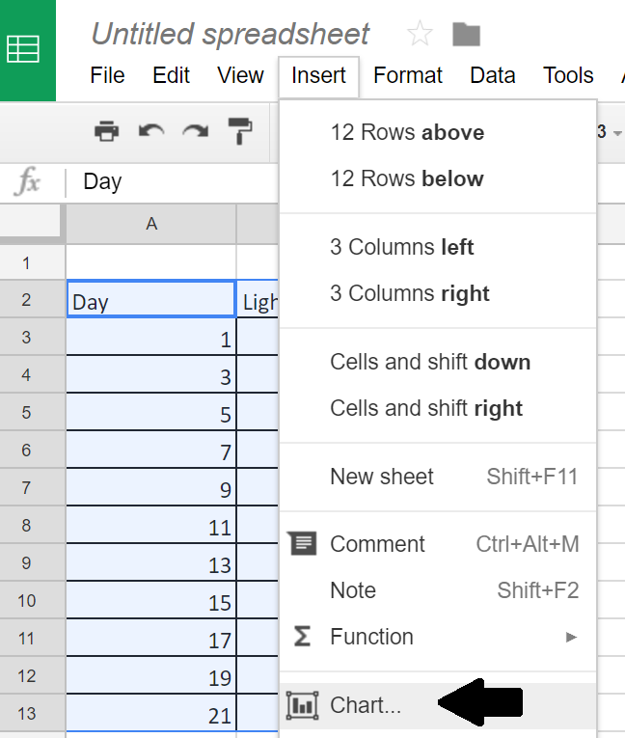
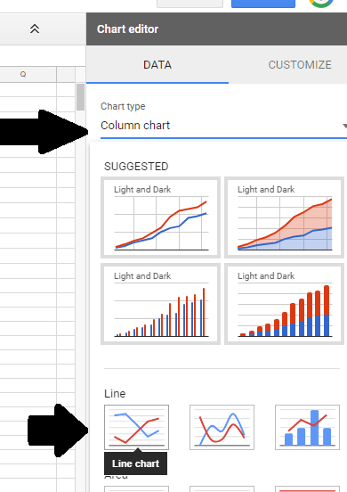
5. Highlight your data table in sheets
6. Click on insert, then chart
6A. You may have to change it to Line chart, Do so by click on
chart type in the upper right hand corner, Select Line Chart

Slide 6
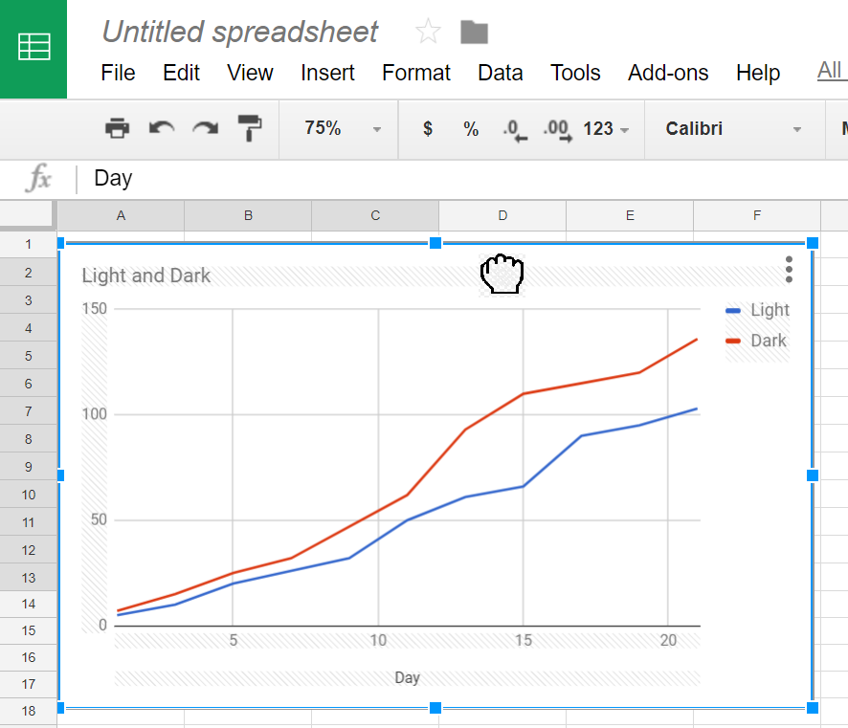
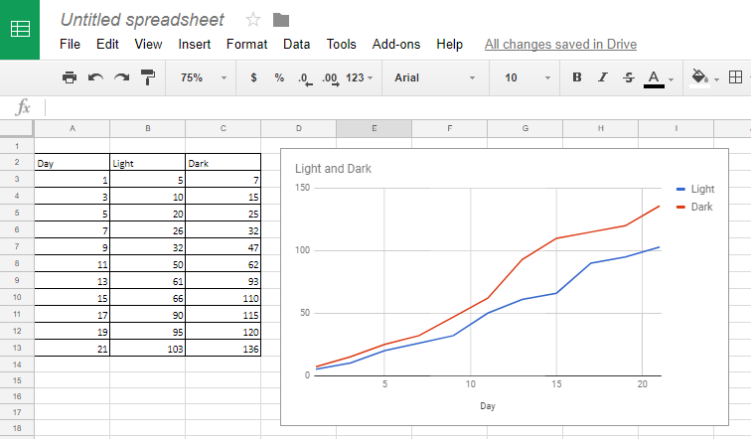
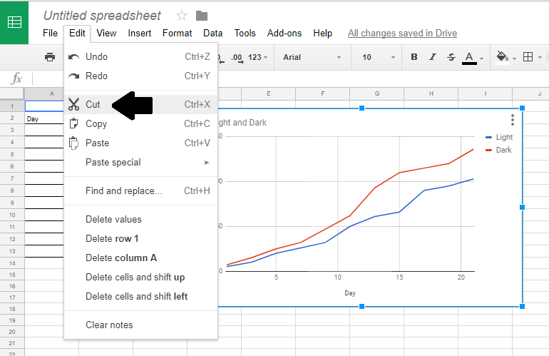
7. Click on the chart till you get a hand icon, and then drag it off your data table.
8. Click on your graph, Click on Edit, Click on Cut

Slide 7
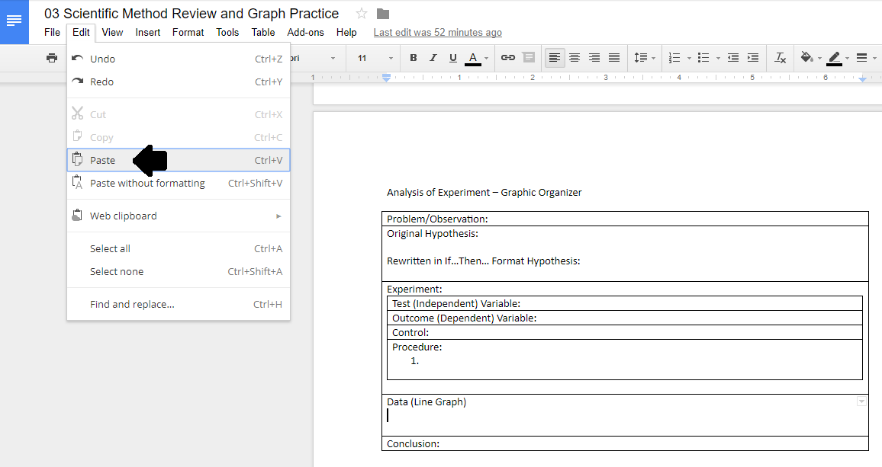
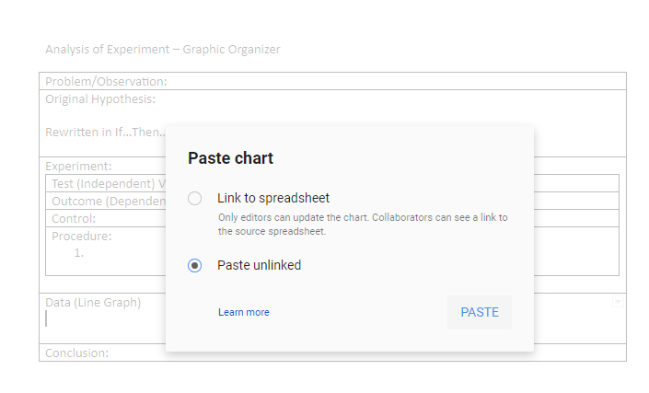
9. Click back into your Google Doc file, Click where the graph needs to be placed, Click Edit, Click Paste.
10. Click Paste Unlinked, Then Paste. You are now done.

